Slide 1

Debit Union Analytics
Let the model do the modeling.

Slide 2
Current Prediction Approach - Flaws
Copyright Debit Union 2022©
Large amounts of time analyzing case-by-case, bottlenecks speed
Accuracy Plateau: high cost for diminishing returns
Ad-Hoc processes may have underlying faults and biases worth reexamination
Process maintenance & information turnover has possible loss
Possibility of human bias and error
Notes:
The bureau is currently spending millions of dollars each year employing expert teams. These teams are constantly bogged down with work factoring in hundreds of variables for each credit report. Experts in these teams need to keep track of a massive amount of information about these variables and their trends over time. Quite a lot of this information is kept ad-hoc, and passing it down can often result in information loss on turnover. Additionally, these experts are still susceptible to human error and even possibly susceptible to human bias.
Our current expert decision practices may not be perfect in terms of accuracy and precision. It’s possible that they could just be looking at 2 or 3 variables (for example just the credit documents) without leveraging other underlying features that truly have more weight in the predictions. We can get the right answer for wrong reasons and vice versa.
Each loan takes quite a lot of time for our experts to process.

Slide 3

Proposal: Employ Machine Learning
Design It Right
Give Diligence to Process
Notes:
Design it right principles should be integral to this process. We would rather lose out on potential gains and spend more budget on R&D than lose money to pick up ML with not enough time to flush-out by deadline and have this be wasted and become on of those companies that “tried machine learning and it didn’t work.”
Following the principles of the Industry Standard CRISP-DM process of developing this iteratively and multi-phased process. Each step in development requires that the previous was done well, because they subsequently depend on each other. The gain must be understood.

Slide 4
Introduction to Machine Learning
Copyright Debit Union 2022©
?
Machine Learning is computers learning data relationships using algorithms.
It can be broken into Training and Projection
Training
Projection
Data Understanding
Data Preparation
Modeling
Evaluation
Deployment
Notes:
Machine learning is essentially the way computers learn relationships between data through statistical and mathematical techniques.
During training, the computers will have various techniques applied to configurations of the data, and during projection, the models will spit out values - usually either a classification or a number.
Engineers employing machine learning techniques will go through phases of data understanding/analysis, data preparation, modeling, evaluation, and deployment. These phases are incremental and may cycle and back track as they build off one another. If one stage is rushed or not explored properly, then the output of the model will see a difference.

Slide 5
Benefits of Using Machine Learning
Disadvantages of Machine Learning: Learning Machine Learning
Faster Predictions, better Expert Utility
Increased Precision & Accuracy of Predictions (up to 20%)
Future Improvements
Future Applications
Edge on Competition
Notes:
The bureau is currently spending millions of dollars each year employing expert teams. These teams are constantly bogged down with work factoring in hundreds of variables for each credit report. Experts in these teams need to keep track of a massive amount of information about these variables and their trends over time. Quite a lot of this information is kept ad-hoc, and passing it down can often result in information loss on turnover. Additionally, these experts are still susceptible to human error and even possibly susceptible to human bias.
Our current expert decision practices may not be perfect in terms of accuracy and precision. It’s possible that they could just be looking at 2 or 3 variables (for example just the credit documents) without leveraging other underlying features that truly have more weight in the predictions. We can get the right answer for wrong reasons and vice versa.
Each loan takes quite a lot of time for our experts to process.

Slide 6
How Much Better? Low-Ball Business Potential
The fact you are looking at this footer means the large number failed to grab your attention
$167,000,000
How much at minimum a 1% prediction improvement brings per annum¹
Notes:
This value was calculated at a low-ball mortgage rate and did not account for the fact that failing to predict defaulters brings in significantly-more value in savings (since the bureau would need to pocket out the entire loan principle averaging 160k plus overhead as opposed to losing potential profits of 68k)
Truly there is MUCH more value in the business case. Between expert utility, competitive edge, future trend analytics, increased prediction speed, and internal investment in models that could apply to other loan forms, and other hidden values. This number could easily be much more than this.
So implementing machine learning for loan prediction could easily bring in $150 million which is otherwise falling out of our pockets.

Slide 7
Data Understanding
If you truly understand the data of this slide, you’ll know that the comb is made of ‘I’ characters
Why?
What was Performed
Verifies Model is apt
Analyzed data with a fine-toothed comb
IIIIIIIIIIIIIIIIIIIII
Obtains clues for obtaining expert knowledge
Heavily Researched metadata
Determines Risks
Determined correlation, gaps, and data nuances
0100 100110
Data Understanding is explored and evaluated in-depth in the Data Analysis section
Notes:
Before any algorithms are ran, the first part of the Machine Learning process past business understanding involves REALLY looking into the data.
We need to understand that the data associations that our model is built upon are sound so that accuracy can truly be well-founded.
Through having a strong understanding one can get clues for better leveraging expert knowledge, and determine risks and valuable insights well ahead of time.
Through the source code, one can see that the data was analyzed with a fine-toothed comb. Our ML engineers performed statistical analysis that was evaluated on EVERY variable in the dataset, noting important statistical points, viewing the distributions and heatmap correlations of each variable.
The metadata was heavily documented in homeColumnsDescription.csv. This metadata was verified with pie charts, bar plots, statistical descriptions, and sample analysis

Slide 8
Data Understanding: Findings
Copyright Debit Union 2022©
Determined organizational and ethical risks
Data preparation insights that improved model precision by 5%
Insights towards potential algorithm applications
100110
Insights towards improving the collection process
Notes:
Through variable and data analysis, we were able to ascertain several organizational and ethical risks, charted in later slides. Through thorough data understanding, these risks were able to be noted and mitigated starting very early in the ML process.
Looking at null entries, processing of DAYS_ variables, categorical distributions, and statistical values (particularly max/min outliers) we were able to gain insights that used in data cleaning improved model precision by 5%. Remember that slide 6 has a price point of over 150 million for 1%...
We were also able to gain insights on algorithms to further improve accuracy down the line. Previous data applications allow for us to leverage expert opinion through bayesian inference. Time-stamped balances and payments also provided us insights for algorithms that improved accuracy as well.
Finally, data exploration brought insights in improving the data collection process. Many of the variables are not stored in intuitive, consumable formats, and many of the categorical variables are quite nuanced. Many of the housing data variables are pre-processed as statistical data, which may not be preferable compared to an absolute source of truth in raw data. There were quite a few missing values, which aside from being a potential risk, should be looked into.

Slide 9

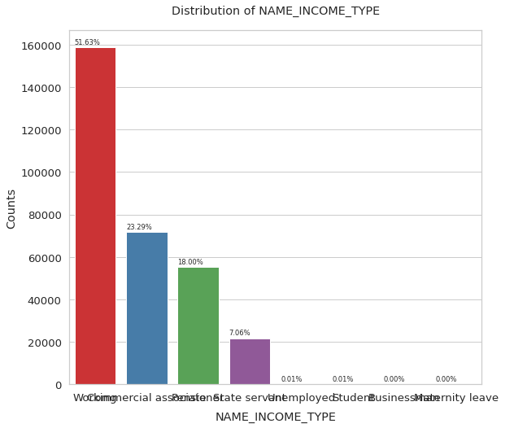
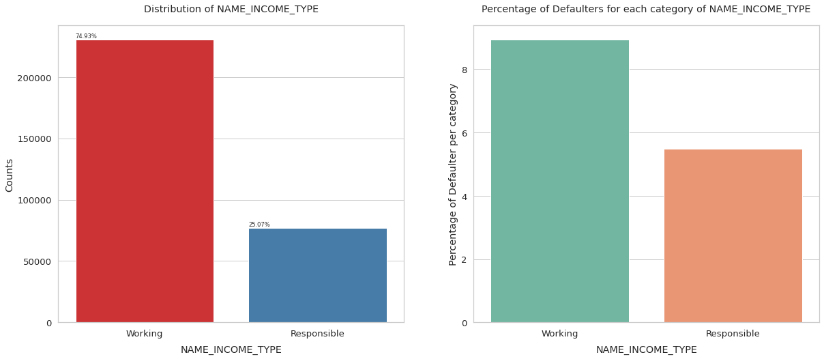

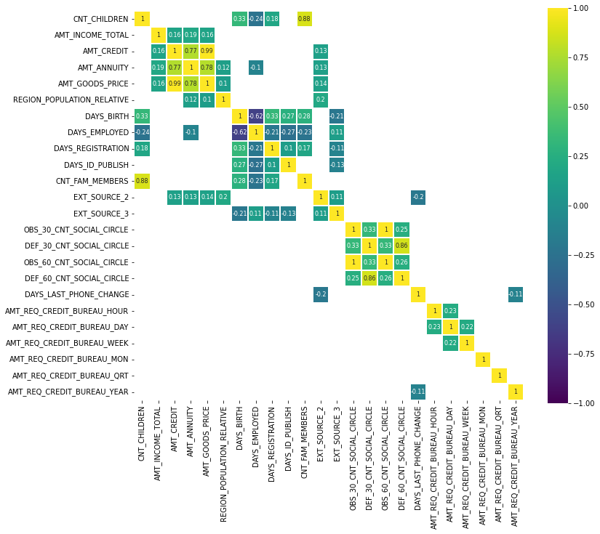

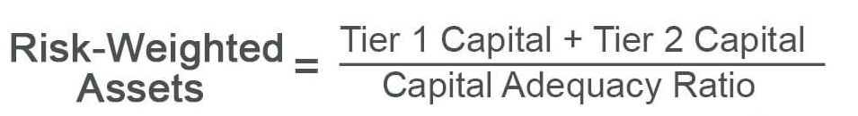
Data Preparation
The exception of the analogy is that you repeat data preparation many times, and only wash the food once.
Cleaning
Selection
Generation
Data Preparation is explored and evaluated in-depth in the Feature Selection section
Notes:
Similar to cooking - the finest dishes require the finest ingredients. To prepare a fantastic dish, the cooks clean the produce, select ingredients only ingredients that add to the recipe, and prepare seasonings & sauces from ingredients that enhance the final quality of the dish. Likewise in data preparation, we clean the data, select relevant features, and generate features that improve model performance.
After our analysis, we performed very detailed data preparation. This brings up the performance of our models, and the robustness of their precision from the underlying data. If we feed our algorithm garbage, it will produce garbage. So we took great measures to ensure that the data fed into the model was very well-prepared.
The cleaning involved removing noise through dealing with outliers (which we tested the ramifications via removal, windsorization, and setting modal values), representing the days_ variables intuitively, and reducing out certain meaningless entries in categorical variables. Later, the categorical variables are also encoded into numerical representations for the models, and variables are scaled as well.
For feature selection, many useless variables were removed, and various under-represented categories were removed as well to greatly reduce dimensionality.
For feature generation, we found increased performance against the baseline in aggregating highly-correlated variables to reduce dimensionality. We created more generalized categories to gain value from categorical variables that would have otherwise greatly damaged the dimensionality. Additionally, we generated/combined various variables in correlations from known expert equations to enhance precision and target correlation.

Slide 10
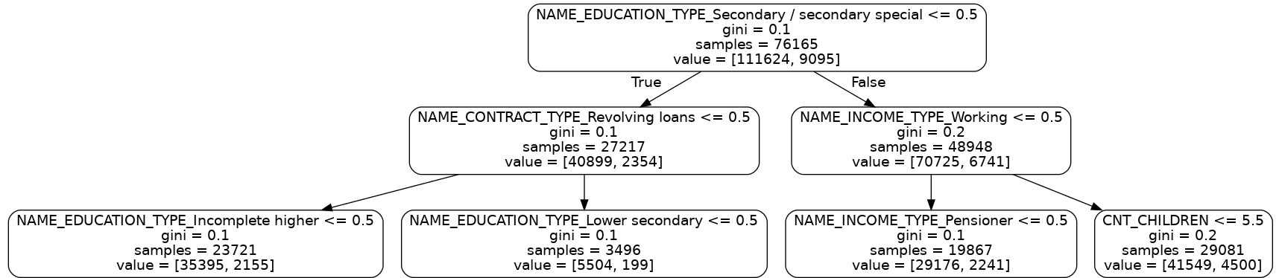
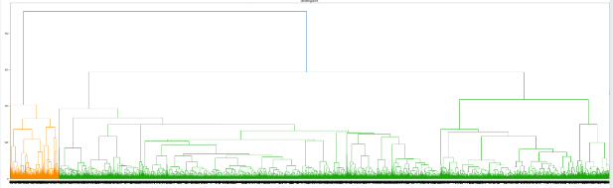
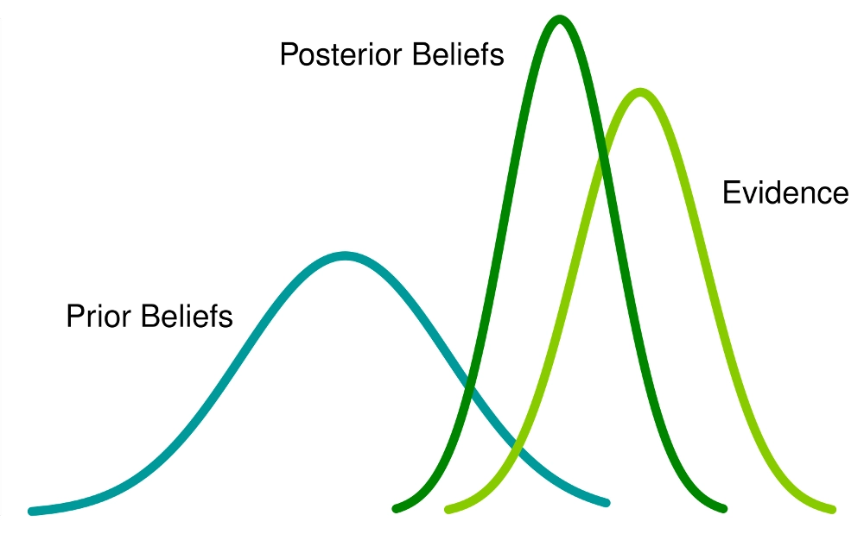
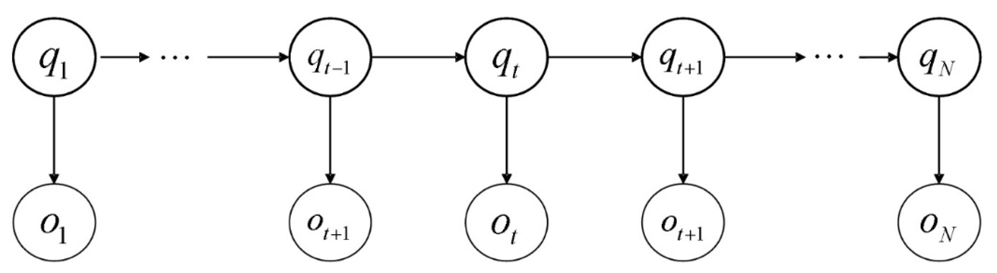
Modeling
The exception of the analogy is that you repeat data preparation many times, and only wash the food once.
Classification Trees
Unsupervised Learning
Bayesian Methods
x
Hidden Markov Models
Notes:
Specific Algorithms have been hand-selected and tuned for models.
Supervised learning employed use of single random decision trees and various sizes of random decision forests in determining variable significance and predicting outcomes in such a way to minimize bias.
Unsupervised learning using K-means and Hierarchical clustering enabled models to cluster variables based on similarities while reducing dimensionality and ambiguity behind the models.
Bayesian Inference provided leveraging of previous data to make future predictions. This allowed for a re-evaluation of existing expert norms and the leveraging of these trends in a scalable, dynamic way.
Hidden Markov Models allowed the addition of valuable variables to the gradient boosted tree, which would have otherwise not been utilized to full potential. The leveraging of time-based data allowed for algorithms that improve the performance metrics of our model in a way that is nuanced to this particular dataset.

Slide 11
Evaluation
Metrics
Model Generated from Gradient-Boosted Tree
The measuring tape is also constructed of ‘i’s
I I I I I I I I I I I
IiiiiiiIIiiiiiIiiiIiiiiiiiiiiiiiiiiiiiiiiiiiiiiiiiiiiiiiiiiiiiiiiiiiiiiiiiiiiiiiiiiiiiiii
Baseline
Selection
Generation
Accuracy
Precision
Recall
F1-Score
Accuracy
94%
95.5%
96%
Precision
31%
33%
34%
Recall
1%
2%
2%
Powerful classification algorithm, solving 62% of the winning Kaggle solutions
Provides high classification accuracy
Specifically robust against misclassification & false positives through weighting
Fast response time if no refitting necessary
F1-Score
3%
1%
1%
Notes:
Throughout the data preparation and modeling phases, the performance of the model was incrementally evaluated against the previous baseline.
When evaluating and determining whether or not an algorithm or preparation decision improved the performance of the classification algorithm, we looked at multiple metrics - the first being accuracy, which is intuitive to the layman’s definition.
Precision was looked at in near equal grounds with accuracy, which takes into account false positives and bias resulting from poor distributions of classes - which was particularly relevant to the data behind these models.
Many categorical variables, and the loan defaulting variable of interest were moderately or severely imbalance (though measures were taken in the data preparation phase). Precision was regarded as particularly important when evaluating the models because of the false positive cost. Failing to offer a loan to a customer who would have been likely to pay it back costs on average $70,000 of profit with the unseen business costs of losing customer regard and feeding our competition. So improving the precision by 1% is more valuable than improving the accuracy by 1% due to the cost of false positives.
Recall was also evaluated behind the model’s classification output.
These metrics were largely baselined against the performance of predictions made by the model fitted to the gradient boosted tree.
The accuracy produced by the model sees fairly high accuracies, which are already likely higher than that of expert opinion, and have room for improvement.

Slide 12
Regulatory Risks
It would be a disaster if private user data leaks and is used as open source for a Kaggle competition. Digital equivalent to having pre-med students operate on ones cadaver.
Risk
Mitigation
Non-Financial User Demographics
Removing background-based parameters CODE_GENDER, REGION_RATING, REGION_RATING_CLIENT_W_CITY
User Data Privacy
Removing demographic parameters, ensure data governance best practices for anonymity
Auditability
Maintain absolute source of truth for data governance
Notes:
Federal Regulators must be convinced that demographic variables & their surrogates were not used to make decisions. While in other industries this may have solely been an ethical risk, in financial loan industry, this is truly an organizational risk. In order to mitigate this risk, any demographically-correlated user data was identified during data understanding phase, analyzed, and eliminated from the models.
There is some ambiguity about the storage, maintenance, and transfer of the user data. When building machine learning models, it is best to be absolutely assured of the security and privacy of the underlying data. While this measure may not be easily taken from a machine learning perspective, it’s important to work alongside the data custodian and ensure best practices are being taken (k-anonymity, data aggregation, etc.) to ensure user data privacy and security.

Slide 13
Operational Risks
Copyright Debit Union 2022©
Risk
Mitigation
Data Gaps/Prediction Stability
Missing data dropped or inferred during data preparation. Models created from algorithms designed to optimize precision
Unknown Data Governance
Request to familiarize data gathering and gatekeeping process
Cyber
Ensure following gold standards for security in data management
Notes:
The operational risks involved with adopting machine learning techniques are largely technical in nature.
There were data gaps which can indicate flawed capturing and maintenance processes and may compromise future models. For now all models are trained to drop or possibly infer from other highly-correlated variables.
For this process, we additionally were unaware of the particulars of the data generation and storage, which can be of great risk regarding the privacy of user data. This risk may not necessarily be particular to the ML process. But it would be best practice certainly to become closely familiar of the gathering and gatekeeping process behind the data. It is also quite likely that much of the data (e.g. EXT_SOURCE_<>) is generated from external credit sources, which are some of the most valuable variables in the model as well. Maintaining privacy and confidentiality with external bureau sources is also key in mitigating these certain operational risks.

Slide 14

Ethics and Loan Decisions: Background
Background
We get our best and brightest interns to update copyright headers every single year ©
Loan decisions are impactful: our users trust us
We make business decisions regardless of one’s background
This is good business practice
Our company holds highest value in “Shaping Solutions with SOUND JUDGEMENT”
Notes:
Maybe we reduce out the gender flag and the regional ratings so that we aren’t favoring specific genders or users from lower income areas. Here we also can show that we still have some statistical significance and some highly correlated variables so we aren’t losing value in our dataset. This could function as a good mitigation towards these risks.
Maybe throw in some charts on how we could be doing this right now with gender_flag and Target, and then with gender_flag and amt_income.
Likewise with the regional ratings and amt income.
So while the models’ decisions may remain sound, they are not directly influenced by biased variables
This aligns with our company’s value of “Leading by Example,” and “Shaping Solutions with SOUND JUDGEMENT”

Slide 15
Ethical Risk Analysis
The biggest risk here is adding silly footer comments to a final presentation slideshow
Risk
Mitigation
Biased Variables
Random Oversampling, Underweighting, Various Techniques
Non-Financial User Demographics
Removing background-based parameters
Model Making Financial Decisions
ML makes recommendations, experts get final say
AI Taking Jobs
Experts used to improve process. High skill jobs added for Machine Learning & Data Collection
Ethical Risks are explored and evaluated in-depth in the Ethical Analysis section
Notes:
Maybe we reduce out the gender flag and the regional ratings so that we aren’t favoring specific genders or users from lower income areas. Here we also can show that we still have some statistical significance and some highly correlated variables so we aren’t losing value in our dataset. This could function as a good mitigation towards these risks.
Maybe throw in some charts on how we could be doing this right now with gender_flag and Target, and then with gender_flag and amt_income.
Likewise with the regional ratings and amt income.
So while the models’ decisions may remain sound, they are not directly influenced by biased variables
This aligns with our company’s value of “Leading by Example,” and “Shaping Solutions with SOUND JUDGEMENT”

Slide 16
Thank You
While I found it painful at times to have all assignments based on a single dataset I struggled with from the beginning, I learned quite a lot in your class. I appreciated the opportunity to code rather than study. So thanks for taking the time to look at my work and I appreciate all of your feedback and the thoughtfulness you have shown me and my peers. -Ian

Slide 17
References

Slide 18
References
Machine Learning Metrics:
Carvalho, D. V., Pereira, E. M., & Cardoso, J. S. (2019). Machine Learning Interpretability: A Survey on Methods and Metrics. Electronics, 8(8), 832. MDPI AG. Retrieved from http://dx.doi.org/10.3390/electronics8080832
Predictive Gains Compared to Statistical Analysis, Metrics, Risks:
Alonso, Andrés and Carbó, José Manuel, Machine Learning in Credit Risk: Measuring the Dilemma Between Prediction and Supervisory Cost (November 3, 2020). Banco de Espana Working Paper No. 2032, Available at SSRN: https://ssrn.com/abstract=3724374 or http://dx.doi.org/10.2139/ssrn.3724374
Risks and Potential for Improvement
Bacham, D. and J. Zhao (2017). “Machine Learning: Challenges, Lessons, and Opportunities in Credit Risk Modeling”, Moody’s Analytics Risk Perspectives, 9.
Machine Learning Metrics:
Carvalho, D. V., Pereira, E. M., & Cardoso, J. S. (2019). Machine Learning Interpretability: A Survey on Methods and Metrics. Electronics, 8(8), 832. MDPI AG. Retrieved from http://dx.doi.org/10.3390/electronics8080832
Ethical Risk Analysis:
De Andrés, P., R. Gimeno and R. Mateos (2019). “The gender gap in bank credit access”, Working Paper No 1945. Banco de España
Gradient Boosted Trees Metric:
Petropoulos et al (2019a, b). “A robust machine learning approach for credit risk analysis of large loan level datasets using deep learning and extreme gradient boosting”, Are Postcrisis Statistical Initiatives Completed, No. 49.

